Slide 1

Hate Speech analysis for DHL express
Prepared by
Naitik Shukla
Senior Data Scientist
For – Interview(Apr_2024)

Slide 2
Introduction and Key Points
Problem: The growing presence of online hate speech and abusive language on social media and online platforms is a significant issue that affects the quality of online discourse and interactions.
Impact: Online hate speech can lead to cyberbullying, harassment, and toxicity, creating an unwelcoming environment for users and hindering constructive conversations and civic participation.
NLP Community: With its focus on computational analysis of language, the NLP community has the potential to make a significant impact on addressing the problem of online hate speech and abusive language.

Slide 3
Problem and Impact
Growing Problem: Online hate speech is becoming more widespread and accepted, which can lead to a toxic online environment.
Negative Consequences: Exposure to hate speech can have detrimental effects on mental health, self-esteem, and social relationships.
Marginalized Groups: Online hate speech can disproportionately affect marginalized groups, leading to further social exclusion and discrimination.
Real-World Impact: Online hate speech can contribute to an increase in offline violence and discrimination, perpetuating harmful stereotypes and prejudices.

Slide 4
NLP Techniques for Hate Speech Detection
NLP techniques can be employed to automatically detect and classify online hate speech, contributing to safer online environments.
Various approaches have been proposed, ranging from traditional machine learning methods to more recent deep learning and transformer-based models.
Some key NLP techniques for hate speech detection include:
Text classification using machine learning algorithms (e.g., SVM, Naïve Bayes, Random Forest)
Word embeddings for representing text data (e.g., Word2Vec, GloVe)
Contextual embeddings using transformer-based models (e.g., BERT, RoBERTa)
Adversarial techniques for data augmentation and model robustness (e.g., back-translation, adversarial training)
Neural models such as RNNs, CNNs, and transformer-based models (e.g., BERT, RoBERTa)
Notes:
Text Classification: Traditional machine learning algorithms can be used for text classification tasks, such as identifying hate speech or abusive language within text data.
Word and Contextual Embeddings: Word embeddings and contextual embeddings can help capture the meaning and context of words, improving the performance of hate speech detection models.
Adversarial Techniques: Adversarial techniques can be employed to enhance the robustness of hate speech detection models and to generate synthetic data for training and testing purposes.
Neural Models: Recurrent neural networks (RNNs), convolutional neural networks (CNNs), and transformer-based models (e.g., BERT, RoBERTa) have shown promising results in detecting and classifying hate speech in online text.

Slide 5
Applications
NLP techniques for hate speech detection have been applied in various real-world scenarios, demonstrating their potential for addressing online hate speech.
Some case studies and applications include:
Moderating comments on social media platforms: NLP models can be employed to automatically detect and flag potentially harmful content, enabling platforms to maintain a safer environment for their users.
Identifying hate speech in code-mixed languages: Techniques such as transfer learning and multilingual models can be used to detect hate speech in languages where resources are limited, or no annotated data is available.
Analyzing the impact of counter-speech initiatives: NLP can be used to study the effectiveness of counter-speech strategies and assess their potential for reducing the prevalence of online hate speech.

Slide 6
Let's Dive in more details about current technology landscape to handle hate speech
Techniques used in Market.

Slide 7
Text Classification using Machine Learning Algorithms
Machine learning algorithms, such as SVM, Naïve Bayes, and Random Forest, can be used for text classification tasks, including hate speech detection.
These algorithms analyze text data and assign labels based on patterns and features within the data.
Key steps in text classification include data preprocessing, feature extraction, and model training and evaluation.
Notes:
Algorithm Selection: Different machine learning algorithms have unique strengths and weaknesses, making them suitable for different text classification tasks.
Data Preprocessing: Text data must be preprocessed to remove noise, normalize text, and create a suitable representation for analysis.
Feature Extraction: Techniques such as bag-of-words, TF-IDF, and word embeddings can be used to extract features from text data that capture the meaning and context of the text.
Model Training and Evaluation: Machine learning models are trained on labeled data and evaluated using metrics such as accuracy, precision, recall, and F1-score.

Slide 8
Word Embeddings for Representing Text Data
Word embeddings are a way to represent text data by mapping words to continuous vector representations, capturing semantic meaning and relationships between words.
Techniques like Word2Vec and GloVe are popular methods for generating word embeddings.
Word embeddings can be used as input features for various NLP tasks, including hate speech detection.
Notes:
Word Embeddings: Word embeddings are dense vector representations of words that capture their meanings and relationships, enabling better text analysis by capturing context and semantic information.
Word2Vec: Word2Vec is a popular technique for generating word embeddings, using either a continuous bag-of-words (CBOW) or a skip-gram model to learn word representations based on surrounding context.
GloVe: GloVe is another method for generating word embeddings, focusing on capturing word co-occurrence patterns in a corpus and incorporating global word–word co-occurrence statistics.
Applications: Word embeddings can be used as input features for various NLP tasks, such as text classification, sentiment analysis, and hate speech detection.

Slide 9
Contextual Embeddings using Transformer-based Models
Transformer-based models, such as BERT and RoBERTa, can generate contextual embeddings that capture the meaning of words within a given context, improving hate speech detection performance.
These models are pre-trained on large amounts of text data, learning rich representations of language that can be fine-tuned for specific tasks.
Key steps in using contextual embeddings for hate speech detection include model pre-training, fine-tuning, and model evaluation.
Notes:
Transformer-based Models: Models like BERT and RoBERTa are based on the transformer architecture, which allows for efficient processing of long-range dependencies in text data.
Pre-training: These models are pre-trained on large text corpora using unsupervised learning objectives, such as masked language modeling(MLM) and next sentence prediction(NSP).
Fine-tuning: Pre-trained transformer models can be fine-tuned for specific tasks, such as hate speech detection, by adding task-specific layers and optimizing the model on labeled data.
Model Evaluation: Fine-tuned transformer models are evaluated using appropriate metrics, such as accuracy, precision, recall, and F1-score, to assess their performance in detecting and classifying hate speech.

Slide 10
Adversarial Techniques for Data Augmentation and Model Robustness
Data Augmentation: Adversarial techniques can be used to generate synthetic data, increasing the size and diversity of the training set and improving model performance.
Adversarial techniques, including back-translation and adversarial training, can be employed for data augmentation and to enhance the robustness of hate speech detection models.
These techniques aim to improve model generalization and performance by exposing models to perturbations and variations in the input data.
Notes:
Back-Translation: This technique involves translating text data from one language to another and then back-translating it to its original language, creating perturbations and variations in the text data.
Adversarial Training: During training, adversarial techniques can be used to generate perturbations of the input data, and the model is optimized to maintain its performance on these adversarial examples, improving its robustness.
Benefits: Adversarial techniques can enhance model generalization, reduce overfitting, and improve model performance, particularly when dealing with noisy or ambiguous data, as is often the case with hate speech detection.

Slide 11
Neural Models for Hate Speech Detection
Neural models, such as RNNs, CNNs, and transformer-based models, have shown promising results in detecting and classifying hate speech in online text.
These models can capture complex patterns and relationships within text data, leading to improved performance in hate speech detection tasks.
Neural models can be combined with other techniques, such as adversarial training and transfer learning, to further enhance their performance in detecting and mitigating online hate speech.
Notes:
Recurrent Neural Networks (RNNs): RNNs are capable of processing sequential data, making them suitable for text analysis tasks. They can capture long-range dependencies in text data and learn representations that are sensitive to context and order.
Convolutional Neural Networks (CNNs): CNNs can be used for text classification tasks, with filters capturing local patterns and relationships within text data. Combining CNNs with other layers, such as pooling and attention, can further improve hate speech detection performance.
Transformer-based Models: Models like BERT and RoBERTa, based on the transformer architecture, have achieved state-of-the-art results in various NLP tasks, including hate speech detection. These models can capture complex relationships and contextual information within text data, leading to improved performance.

Slide 12
Dig Deeper into our Implementation
Transformer Model - Distilbert-base for Hate speech classification (Hate/No Hate)

Slide 13
Our Setup
Model:
DistilBERT-base
66M parameters
Data:
Hate speech dataset from a white supremacist forum - Stormfront (Link)
Train – 1913 labelled data
Test – 300 labelled data
Class – 2 (Hate/NoHate) Balanced
Compute
PyTorch
Python
Link to GH repo
Notes:
Github repo for code: Link

Slide 14
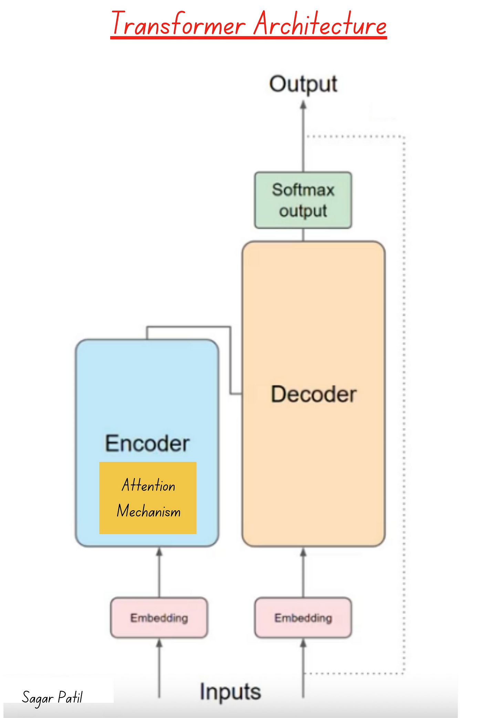
At Core of our Models lies...
Transformers
Timeline of popular Transformer model releases
Notes:
Three type of Transformers Model currently in Market:
Encoder-only models: Good for tasks that require understanding of the input, such as sentence classification and named entity recognition.
Decoder-only models: Good for generative tasks such as text generation.
Encoder-decoder models or sequence-to-sequence models: Good for generative tasks that require an input, such as translation or summarization.

Slide 15
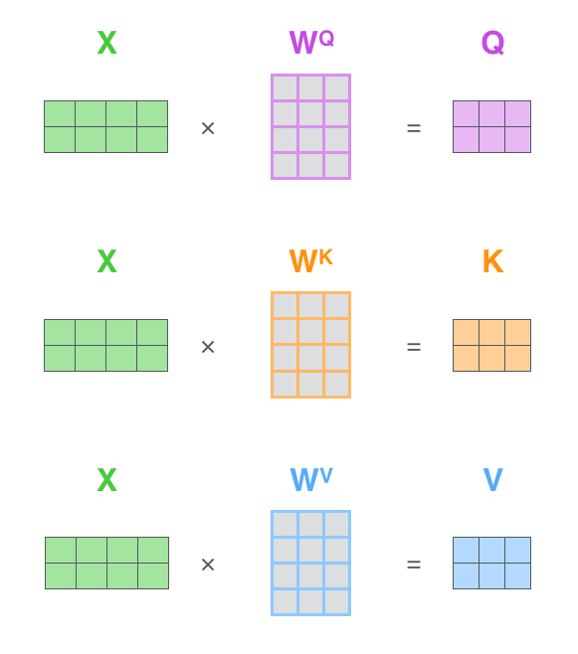
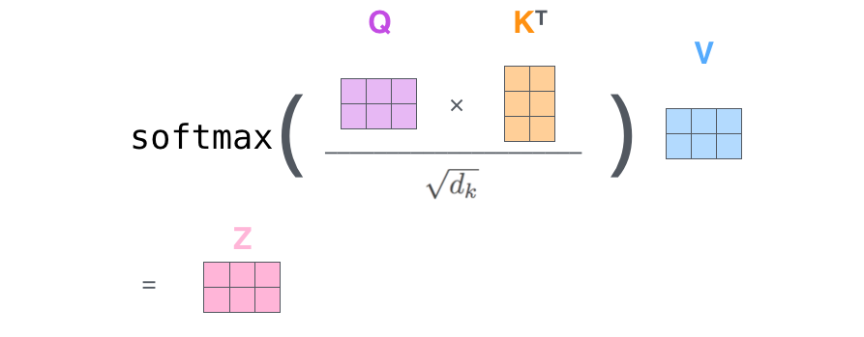
Attention Is All You Need!
Attention is a mechanism used in neural networks to selectively focus on certain parts of the input when processing it.
In natural language processing, attention is used to weigh the importance of different words or sub-phrases in a sentence when generating a prediction or output.
Attention mechanisms have been shown to improve the performance of neural models on a variety of NLP tasks, such as machine translation, text classification, and sentiment analysis.
Self Attention in Matrix Form
Notes:
Understand Attention: Link
Visualize attention: Link

Slide 16
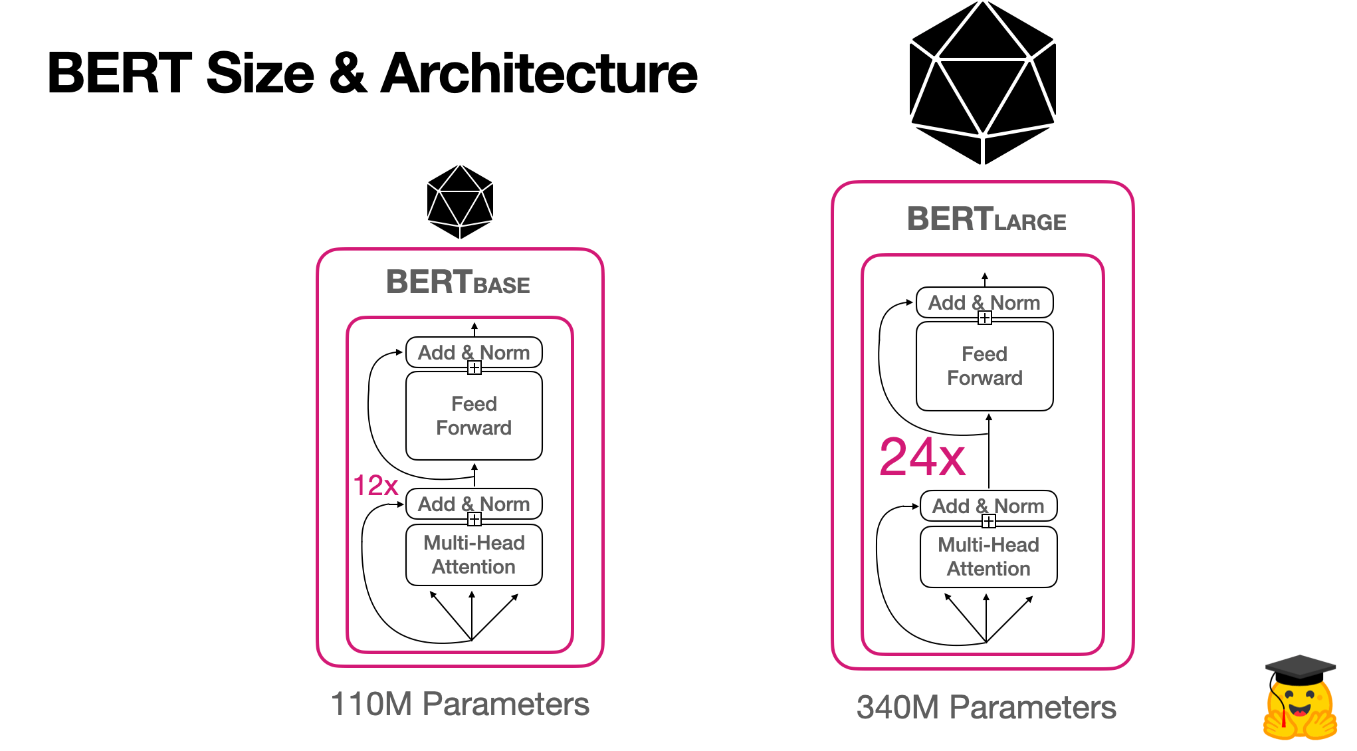
What is BERT? Bidirectional Encoder Representations from Transformers !!
Available Model for BERT
BERT is a pre-trained language model that uses a bidirectional transformer architecture to learn contextualized representations of text.
By fine-tuning BERT on a hate speech detection task, we can improve the accuracy of the model compared to traditional machine learning approaches.
BERT can be used for both text classification and sequence labeling tasks, making it a versatile model for hate speech detection.
Pre-trained on large text corpora using unsupervised learning objectives, such as masked language modeling(MLM) and next sentence prediction(NSP).
Notes:
BERT was specifically trained on Wikipedia (~2.5B words) and Google’s BooksCorpus (~800M words).
MLM enables/enforces bidirectional learning from text by masking (hiding) a word in a sentence and forcing BERT to bidirectionally use the words on either side of the covered word to predict the masked word. This had never been done before. Paper implementation randomly masks 15% of the words.
NSP (Next Sentence Prediction) is used to help BERT learn about relationships between sentences by predicting if a given sentence follows the previous sentence or not.
BERT is trained on both MLM (50%) and NSP (50%) at the same time.

Slide 17
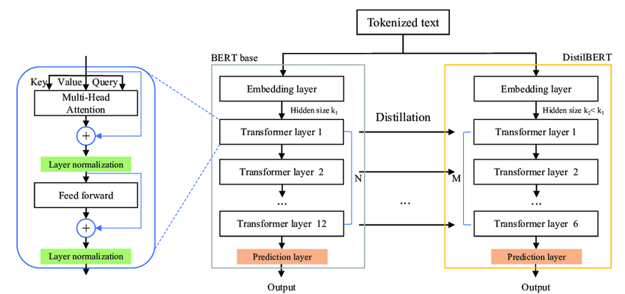
What is DistilBERT: A Compact Transformer Model
Distillation Approach: DistilBERT is crafted using knowledge distillation from a larger model (BERT).
Efficiency Enhancement: Achieves a 40% reduction in parameters and runs 60% faster while retaining 97% of BERT's language understanding capabilities.
Triple Loss Objective: Integrates language modeling, distillation, and cosine-distance losses during pretraining to preserve learned inductive biases.
Notes:
Distillation Approach: Distillation involves transferring knowledge from a large model (teacher, like BERT) to a smaller one (student, DistilBERT). This process helps in reducing model size while retaining performance.
The triple loss objective combines three components during pretraining:
Language Modeling: Predicting the next token in a sequence.
Distillation Loss: Matching the probabilities predicted by the teacher model.
Cosine-Distance Loss: Aligning the hidden states of the student and teacher models.
Example: During pretraining, DistilBERT learns to predict masked tokens while also ensuring that its predictions match those of the larger BERT model. Additionally, it adjusts its hidden states to align with those of BERT, enhancing its ability to capture linguistic nuances.

Slide 18
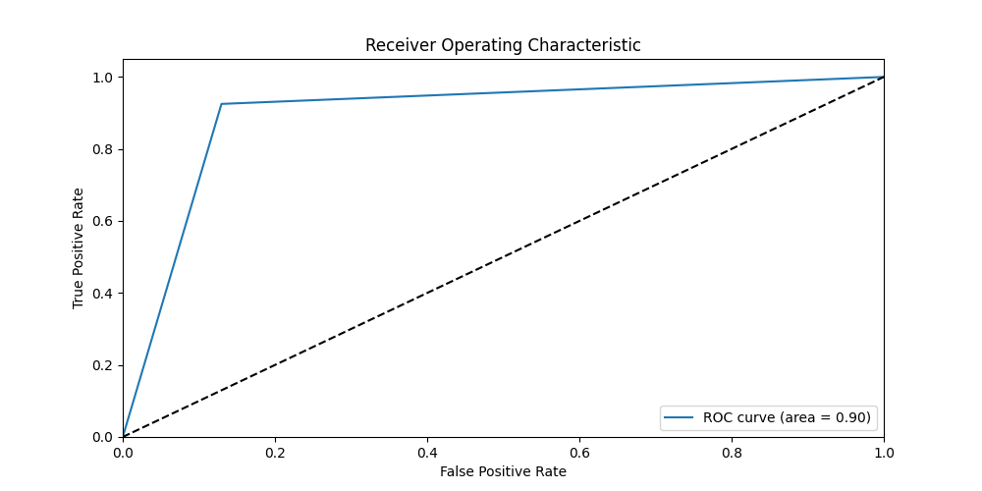
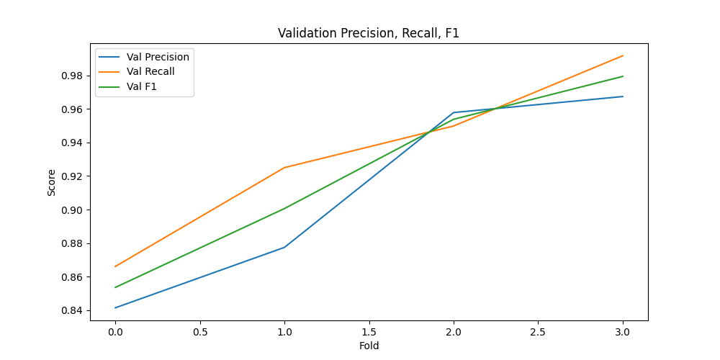
Experimentation Result
Best Model Fold: 3
Epoch 1/2,
Train Loss: 0.26, Train Acc: 0.014, Val Loss: 0.16, Val Acc: 0.004
Epoch 2/2,
Train Loss: 0.12, Train Acc: 0.011, Val Loss: 0.15, Val Acc: 0.004
Confusion Matrix | Actual Positive | Actual Negative
Predicted Positive | 229(TP) | 10(FP)
Predicted Negative | 12(FN) | 227(TN)
ROC-AUC score | 0.95
Notes:
Accuracy: `(TP + TN) / (TP + TN + FP + FN)` - The overall accuracy of the model. In this case, `(227 + 229) / (227 + 229 + 10 + 12) = 0.946` or 94.6%.
Precision: `TP / (TP + FP)` - The proportion of true positive predictions among all positive predictions. In this case, `227 / (227 + 10) = 0.957` or 95.7%.
Recall (Sensitivity)(TPR): `TP / (TP + FN)` - The proportion of true positive predictions among all actual positive instances. In this case, `227 / (227 + 12) = 0.950` or 95.0%.
F1-score: `(2 * Precision * Recall) / (Precision + Recall)` - The harmonic mean of precision and recall. In this case, `(2 * 0.957 * 0.950) / (0.957 + 0.950) = 0.953` or 95.3%.
Specificity: `TN / (TN + FP)` - The proportion of true negative predictions among all actual negative instances. In this case, `229 / (229 + 10) = 0.957` or 95.7%.
FPR: `FP / (FP+TN)`

Slide 19
Future pending work(backlog)..
Fully Customized Classification head after Sequence Encoding of Transformer.
Modify Code for extracting Best Parameter from Kfold and train model with full data.
API endpoint for Model finetuning, with train file upload functionality.
Custom/different loss for different use cases.
Handle for unbalance dataset -
Up sample minority class.
Down sample majority class
….

Slide 20
Possible Usage in Business logic
Personalization:
DHL Express can use machine learning and AI to personalize customer experiences based on their feedback and interactions with the company. By combining hate speech classification with other personalization models, such as recommendation engines or customer segmentation, DHL Express can create more tailored and relevant experiences for each customer, while also ensuring that all interactions are respectful and appropriate.
Predictive Analytics:
DHL Express can use predictive analytics to identify customers who are at risk of becoming dissatisfied or churned based on their feedback and interactions with the company. By combining hate speech classification with other predictive models, such as customer lifetime value or churn prediction, DHL Express can proactively reach out to at-risk customers and take steps to address their concerns before they become major issues.

Slide 21
Thankyou

